Slide 2
COMPANY OVERVIEW
COMPANY PHILOSOPHY
VISION
CORE VALUES
OUR PRODUCTS
MONTECART
CEFUTIC
CURITHRO
CUROXIT
OMEDOP
ZOLOTIC-O
PAZITOP
PAZITOP I.V
CILACURE
MEROXIT
PIRAXIT
CUROGRIP
VITAWORK
BACTORIC FORTE
CUROXIT SOFTGEL
DEFTOID
MEROWORK
MONTECART-F
PRORETIC
STAFGRIP
TIGISTAPH
BUSINESS
CONTACT

Slide 3
Index

Slide 4
Index

Slide 5
Index

Slide 6
Index

Slide 7
Index

Slide 8
Index

Slide 9
Index

Slide 10
Index

Slide 11
Index

Slide 12
Index

Slide 13
Index

Slide 14
Index

Slide 15
Index

Slide 16
Index

Slide 17
Index

Slide 18
Index

Slide 19
Index

Slide 20
Index

Slide 21
Index

Slide 22
Index

Slide 23
Index

Slide 24
Index

Slide 25
Index

Slide 26
Index

Slide 27
Index

Slide 28
Index

Slide 29
Index

Slide 30
Index

Slide 31
Index

Slide 32
Index

Slide 33
Index

Slide 34
Index

Slide 35
Index

Slide 36
Index

Slide 37
Index

Slide 38
Index

Slide 39
Index

Slide 40
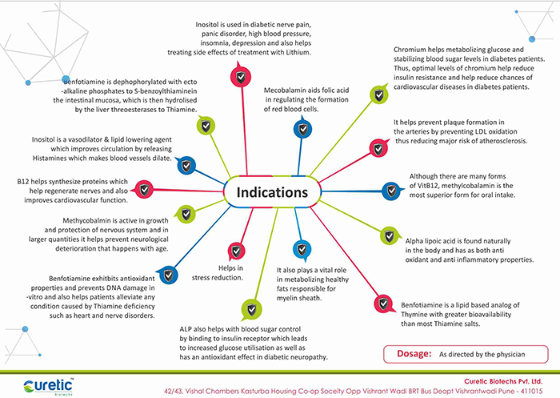
Index

Slide 41
Index

Slide 42
Index

Slide 43
Index

Slide 44
Index

Slide 45
Index

Slide 46
Index

Slide 47
Index

Slide 48
Index

Slide 49
Index

Slide 50
Index

Slide 51
Index

Slide 52
Index

Slide 53
Index

Slide 54
Index

Slide 55
Index

